Slide 1
Lachen Switzerland
ICAMMC March 10th 2011

Slide 2
Ensuring Our Field Personnel Have Been Trained

Slide 3
HSE Training
New Starter Training Plan
Linked to job description and core competencies
New starter inductions
Records held on IMS data base
Specific training for field service personnel
Individual training records held on IMS data base

Slide 4
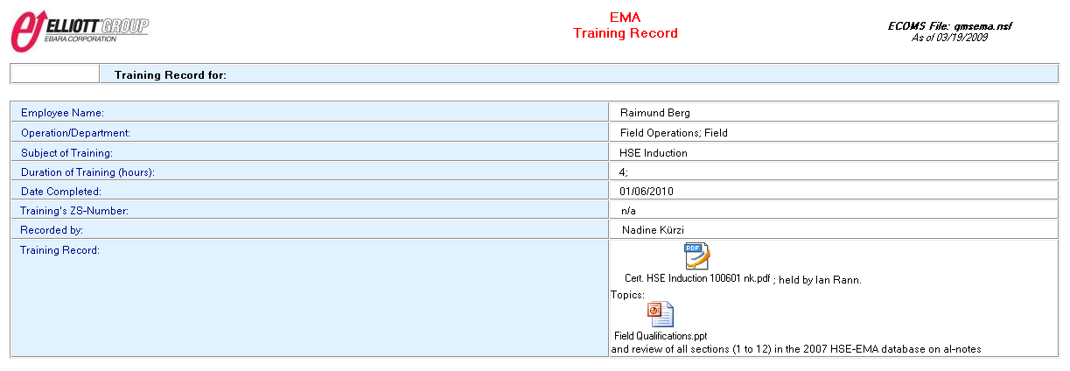
New Starter HSE Training

Slide 5
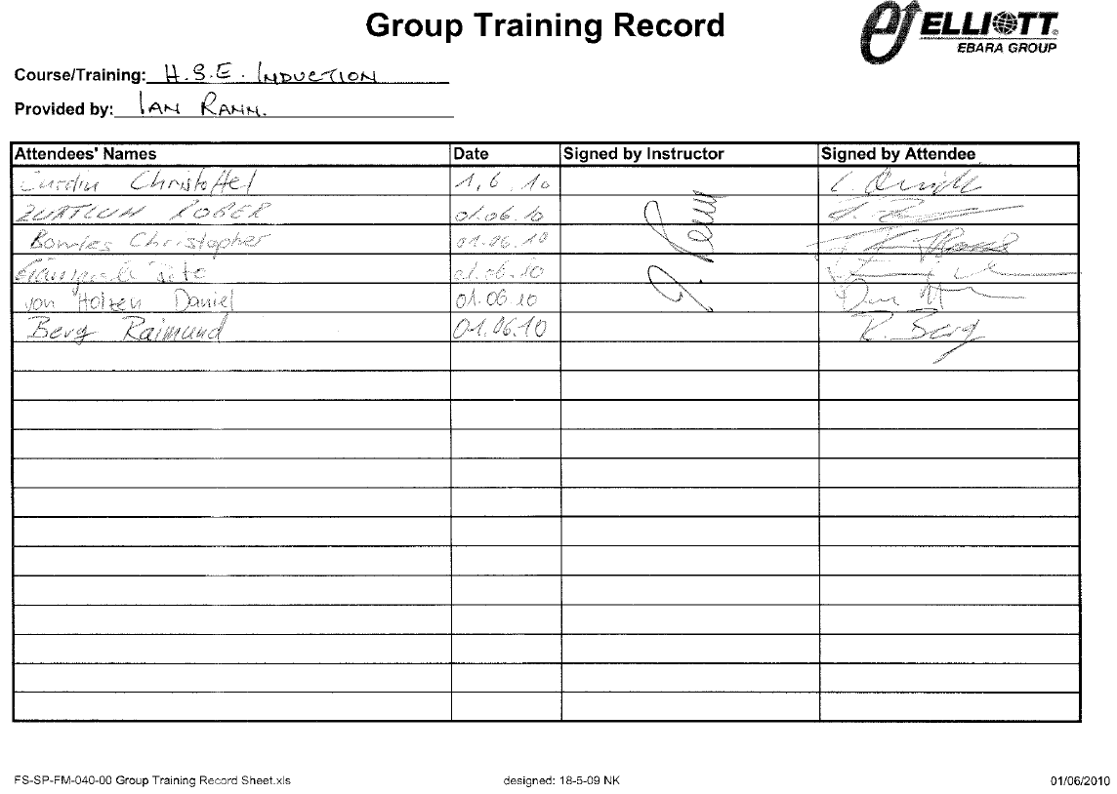
New Starter HSE Training

Slide 6
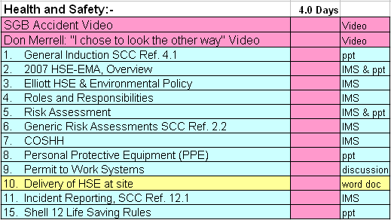
Field Service HSE Training

Slide 7
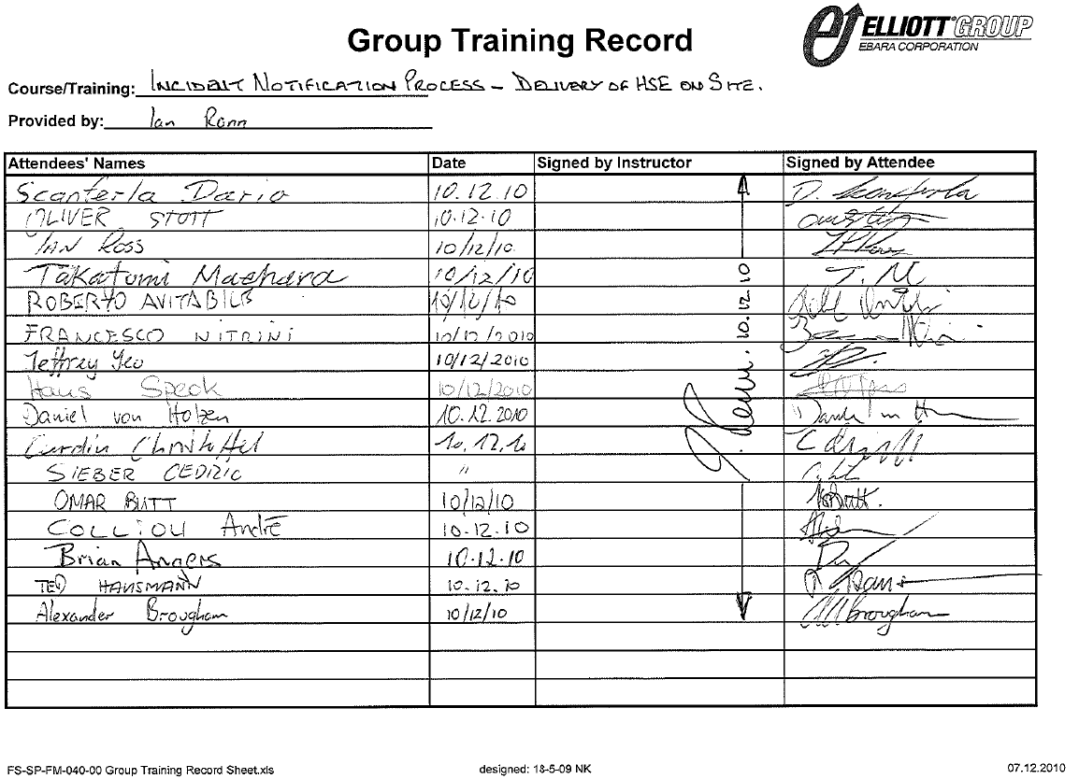
Field Service HSE Training

Slide 8
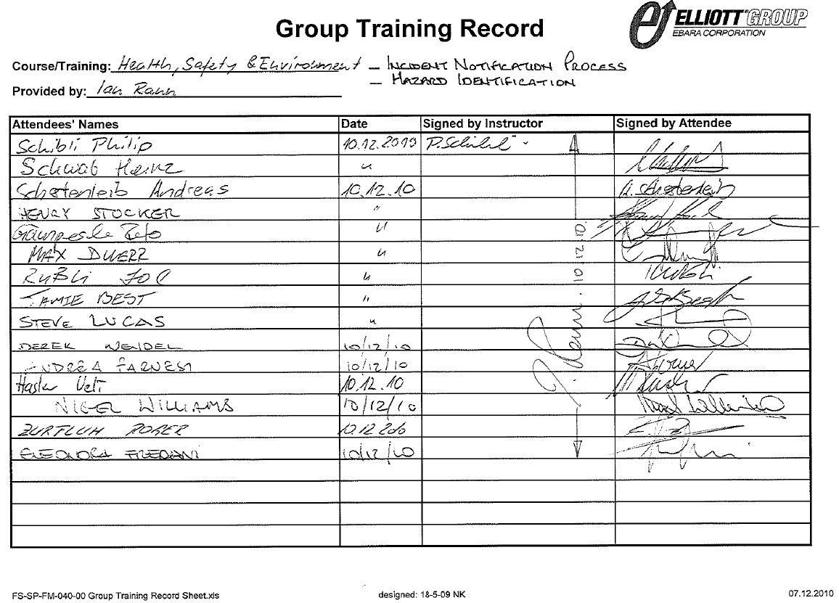
Field Service HSE Training

Slide 9
Field Service Technical Training
New Starter Training
Four weeks theory and practical training prior to any field assignment
Specialist training by third party organisations
Hytorc
Crane operation
Signalling and rigging
Control systems
Soft skills e.g. process innovation

Slide 10
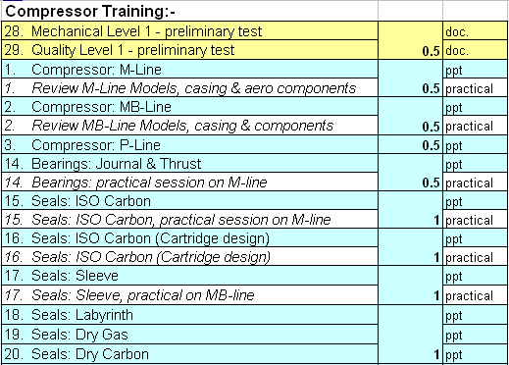
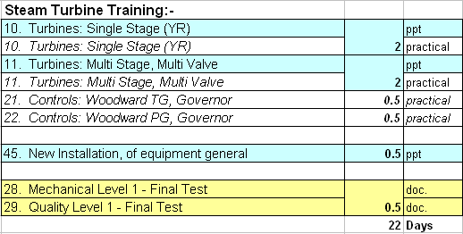
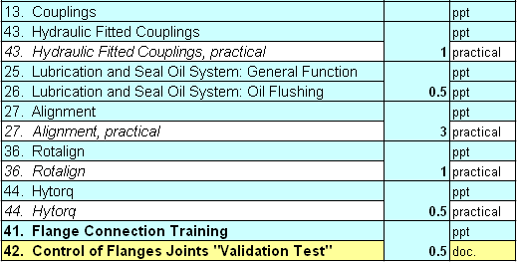
Field Service Technical Training

Slide 11
Communication

Slide 12
Hazard Identification Training
Analyze
Your immediate and surrounding environment for hazards
Think
How could your actions create a potential hazard, what could go wrong?
Act
Remove or mitigate the hazard
Communicate
Immediately to all those affected, and your supervisor, if you are unable to eliminate the hazard!

Slide 13
Hazard Identification Training
Inform Co Workers
Inform of initial hazard
Communicate process change
Warn them of any residual hazard
Information Sharing
Horizontal
Vertical

Slide 14
Feedback

Slide 15
SCC** 2008 Certification
Auditor requires:
Verifiable proof of delivery of tool box talks, risk assessments etc. (SCC 4. Communication of Safety, Health and Environmental Protection)
Formal records maintained on each field project
These are held in HSE database for auditing

Slide 16
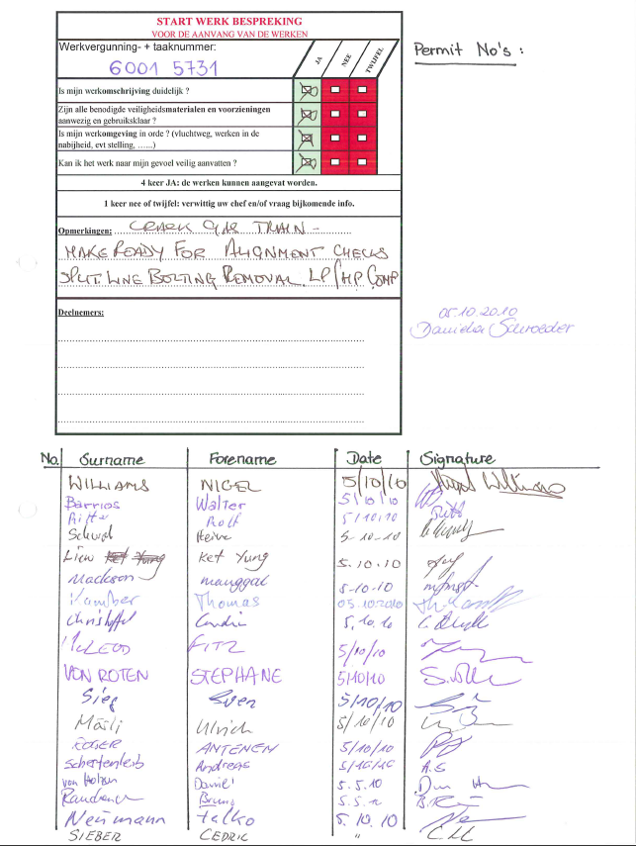
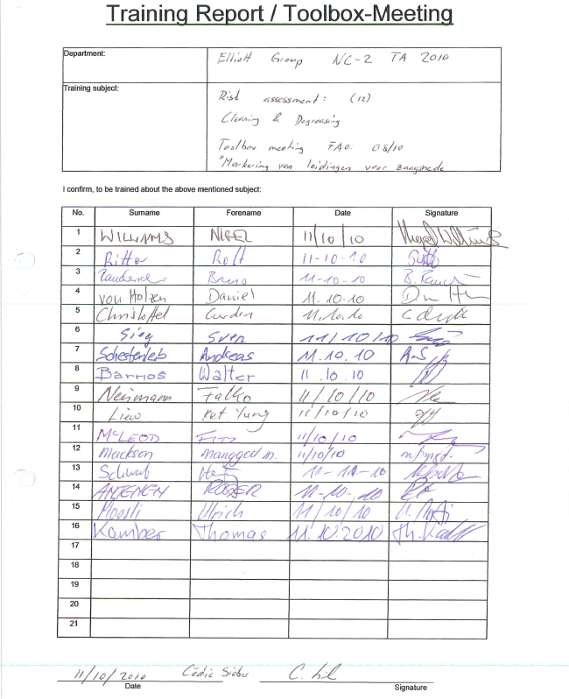

Slide 17
Engaging Our Workers

Slide 18
Engaging Workers
In the past only supervisors delivered toolbox talks and risk assessments
Now we ask individual workers to deliver toolbox talks and risk assessments
In the past only safety audits were made on site
Now we use a new safe visit form requiring discussion with work groups, on the job HSE coaching and commenting on Good HSE Practices as well as Bad

Slide 19
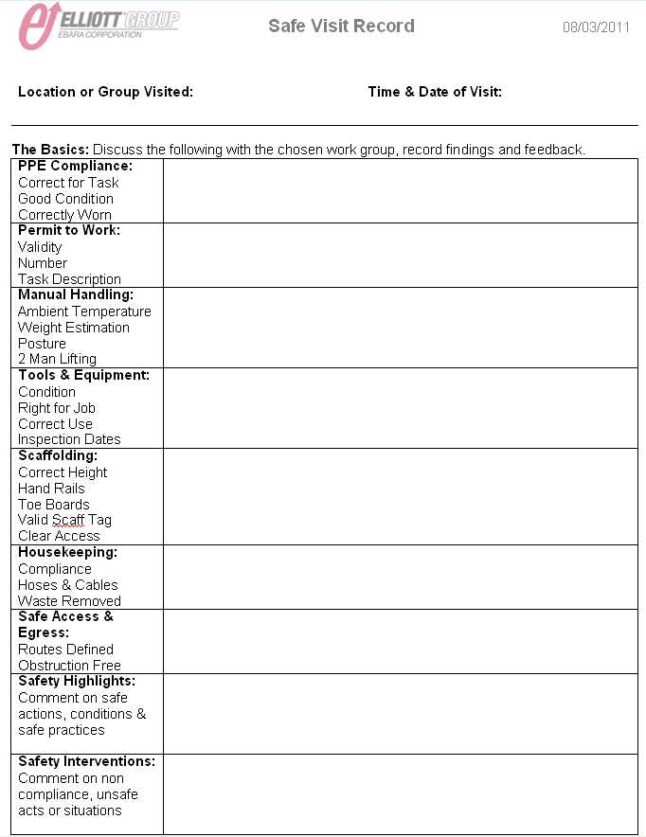

Slide 20
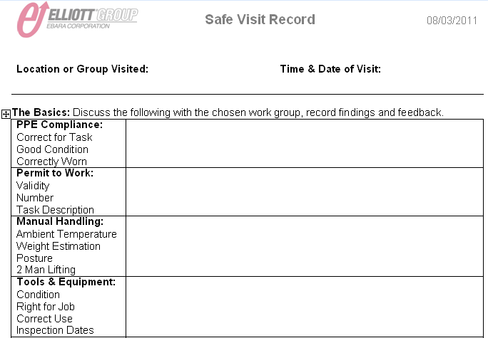
Engaging Workers

Slide 21
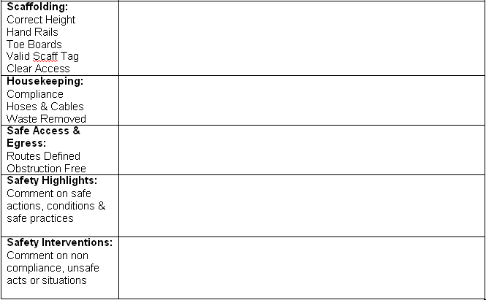
Engaging Workers

Slide 22
Not Sending Someone In Harm’s Way

Slide 23
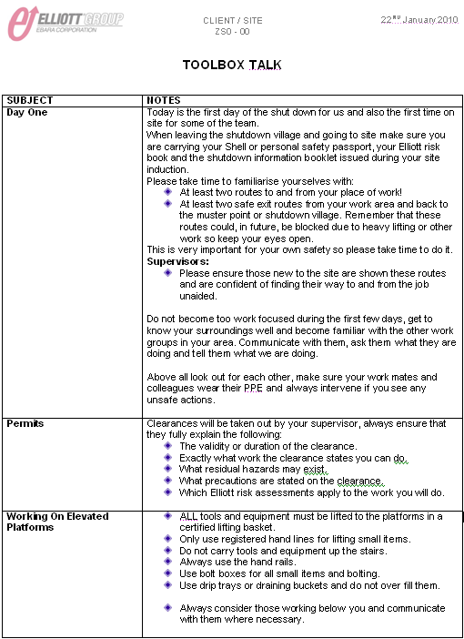
Day One Tool Box Talk

Slide 24
