Slide 1
ICAAMC
Health & Safety Forum
10 March 2011

Slide 2
Agenda
1. Safety in the field
- How do we insure that our folks in the field have been trained,
communicate, engaged, etc?
- That we do not send some one in harm’s way but will send people from
some where else.
- Manage customers that have lesser safety expectations, stop work, etc.
2. Communication
- How do we effectively communicate to promote safety among
our employees
…However… It begins at the top…

Slide 3
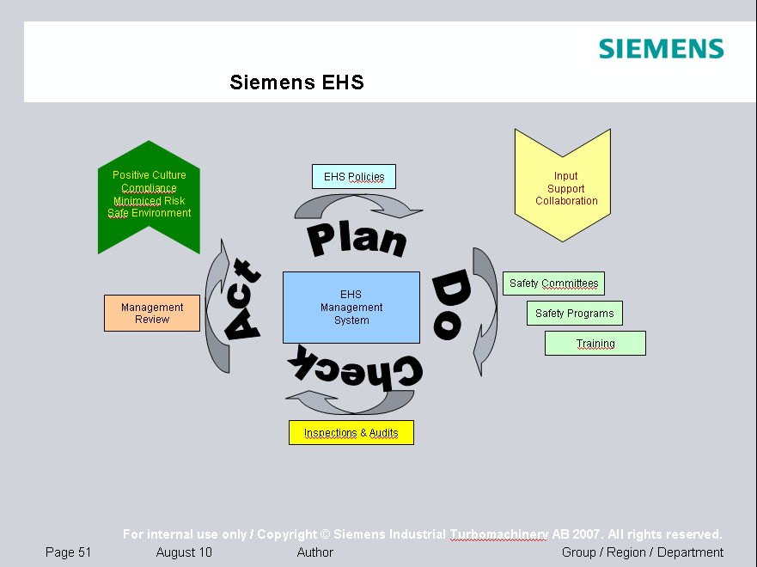
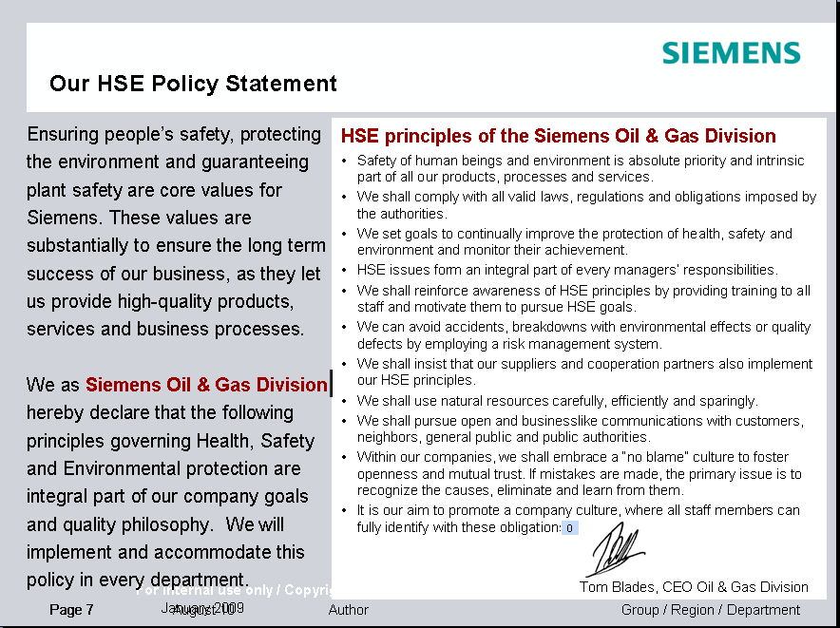

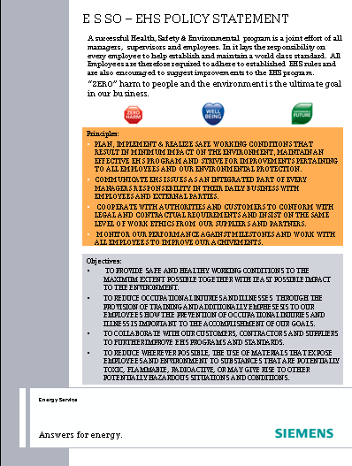
Our EHS affaires
…from an audit perspective…
Overview
Leadership and commitment
Policy and Objectives
Management System
Occupational Health
Risk Management
Siemens has clearly stated HSE goals on different levels in organisation
No harm to people and minimize damage to environment.
Annual improvement targets are set for a range of lagging KPI’s: near misses, first aid cases, medical treatment cases, restricted work injuries, lost time cases and environmental events.
Siemens policy on accidents and losses is based on the principle of risk assessment That is hazard identification, assessment of risk, identification and implementation of control measures, maintain control measures, checking that workers understand the control measures, conducting re-assessments for continuous improvement.
Training
Planning
Reporting & Monitoring
Audit & Review
Communication
Equip. Control and Maint.

Slide 4
1. Safety in the field
How do we insure that our folks in the field have been trained,
communicate, engaged, etc?
Engaging our field staff in EHS training is a mandatory step taken within all field service organisations. Generally we train staff in identified significant risk areas:
  Energy Isolation: Lockout Tagout (LOTO)
  Working at height
  Hoisting & Lifting
  Ex environment & hazardous substances
  Confined Space
Such training is monitored by local organisation, however on global level we request each subregion to declare their planned and executed basic intro training (SCC based). This is the monitored and reported quarterly to management and also posted on our internal intranet homepage accessible by all employees.

Slide 5
Our EHS affaires
…from an audit perspective…
Overview
Training Objectives / Tree levels top-down
Leadership and commitment
To enhance the EHS
knowledge within E S SO.
To highlight key-elements with respect to commitment, risks & responsibilities within the E S SO EHS programme and provide an understanding of ones health, safety and environmental role.
Give a hint of areas for improvement to insure a “healthy” EHS program top-down.
Policy and Objectives
Top
Manage-
ment
Management System
Occupational Health
Sales Management
Risk Management
Training
Project Management
Purchase Department
Engineering
Planning
Reporting & Monitoring
Customer Support Department
Field Service Departments
Field Service Site Management
Field Service Engineers/Technicians
Audit & Review
Communication
Equip. Control and Maint.

Slide 6
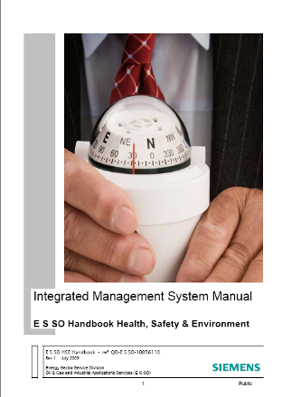
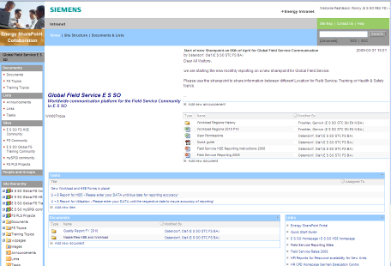
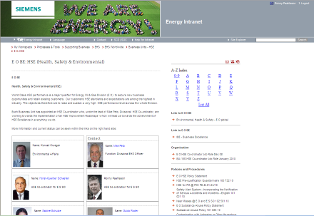
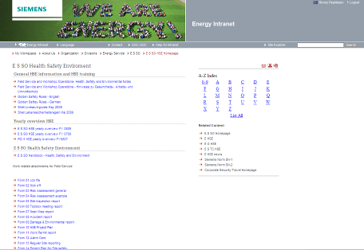

Our EHS affaires
…from an audit perspective…
Overview
E S SO EHS Tools
Leadership and commitment
  The organization offers a wide variety of communication channels for employees, sub-contractors and even customers to inform on HSE affairs…
Policy and Objectives
Management System
Occupational Health
Risk Management
Training
Planning
Reporting & Monitoring
Audit & Review
Communication
Equip. Control and Maint.

Slide 7
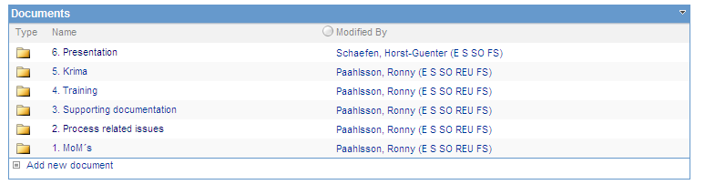
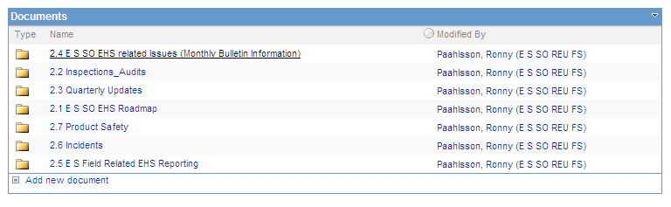
Our EHS affaires
…from an audit perspective…
Overview
E S SO EHS Tools
Leadership and commitment
  The organization offers a wide variety of communication channels for employees, sub-contractors and even customers to inform on HSE affairs…
Policy and Objectives
Management System
Occupational Health
Risk Management
Training
Planning
Reporting & Monitoring
Audit & Review
Communication
Equip. Control and Maint.

Slide 8
Our EHS affaires
…from an audit perspective…
Overview
Risk Assessments
Leadership and commitment
  The organization identifies hazards and assesses potential risks to personnel, the environment and assets. This is done through the use of suitable and comprehensive forms of risk assessment. Control measures are put in place to mitigate the risks. Risk assessments are documented and recorded and routinely re-assessed. Generic Risk assessments are held within the local management systems. Where appropriate risk assessments are kept locally to the work activity.
Policy and Objectives
Management System
Occupational Health
Risk Management
Further activities to manage risks as listed below:
Personal Protective Equipment (PPE)
Environmental Impact Assessment and Monitoring
Chemicals and hazardous substances
HSE data sheets
Environmental properties of chemicals due to be discharged
Emergency preparedness
Training
Planning
Reporting & Monitoring
Audit & Review
Communication
Equip. Control and Maint.

Slide 9
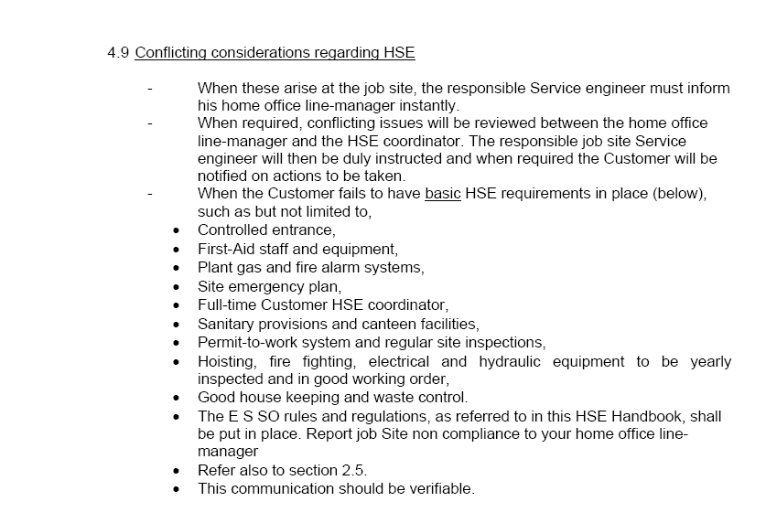
1. Safety in the field
Manage customers that have lesser safety expectations, stop work, etc.…
FS staff is always encouraged to contact home-office whenever a conflict is not finding an immediate and local solution.
Worksite inspections are regularly conducted by siemens local site manager and home-office line-managers to monitor the local operation on customer premisis.

Slide 10
2. Communication
How do we effectively communicate to promote safety among our
Employees?
The awareness management program

Slide 11
2. Communication
“A global leader through safety”
The safety program at
Siemens AG, Duisburg
A program, based on Awareness Management, for the systematic promotion of safety awareness

Slide 12
2. Communication
In order to achieve these objectives, our program will be
based on the following principles:
Organization of responsibility
In other words, occupational safety is a managerial responsibility for all line managers.
Personal responsibility of the employee:
Personal responsibility involves adhering to all safety requirements.
Dealing openly with a lack of awareness:
Instead of ‘apportioning blame’, we will seek to understand what needs to be changed or improved to ensure that the lack of awareness‚ or incident, can be avoided.

Slide 13
2. Communication
Measures and instruments required to achieve our objectives:
Training
Occupational safety in segment meetings
Incident investigation involving employees
Inspection aimed at raising awareness
Active communication of the safety program by onsite managers to their respective employees

Slide 14
2. Communication
Training
Who: All employees will be trained by their line manager
(direct superior).
What: Discussion of the associated risks and/or health-relevant
aspects of the particular role and place of work.
When: Training to take place four times per year, once per
quarter.

Slide 15
2. Communication
Occupational safety in segment meetings
Who: The manufacturing segment leaders with all their direct
team members. Indirect team members may be included.
What: Relevant topics relating to safety and occupational
health.
When: To take place four times per year, once per quarter.

Slide 16
2. Communication
Incident investigation
Who: Direct line managers with a select group of employees, including those involved in the incident and the safety
representative (if available).
What: All work incidents causing one or more days of lost work
(LWC) as well as all First Aid cases and “close calls” which
could have led to a major incident.
When: Incident investigation into its causes should occur within one
working day, and the results of the investigation should be
presented to site management within 48 hours.
Learn: The risk of a repeat incident, and measures required to prevent
this occuring, will be discussed across all site groups.

Slide 17
2. Communication
Inspection aimed at raising awareness
Who: Division management, BU management, site management,
BU segment management, manufacturing segment
management
→ Inspections may not be delegated!
Aims: - To challenge the safety organization.
- To “fly the flag” for occupational safety on site.
- To challenge and promote safety awareness.
Time: In teams of 2, 4 x per year
How: 1. Assessment of safety organization on site
2. Conversations with 1 or 2 employees
3. Feedback provided to the direct superior for the group

Slide 18
2. Communication
Safety steering committee
Who: Division or BU management, site management,
BU segment management, manufacturing segment management and managers of departments where past incidents have occurred, works council, site doctor and occupational safety department. → The same applies for all: Not for delegation!
Aims: - Management of objectives and measures to achieve them
- Require accountability
- Definition of new objectives
Time: To meet at least one time per year, starting April 2009

Slide 19
2. Communication
The following applies for our top performers and colleagues in positions of responsibility:
Support the process with your full commitment and engagement
Fulfill the tasks assigned to you conscientiously and to the highest
quality
Take all appointments seriously
Motivate your employees to do the same
Discuss the program’s implementation with your employees
If we all contribute according to these standards, then our achievements in terms of occupational safety will be outstanding. This is a condition of our long-term success.

